Slide 1

TRAFFIC MANAGEMENT

Slide 2
Table of contents
● Block Diagram
● Working Principal

Slide 3
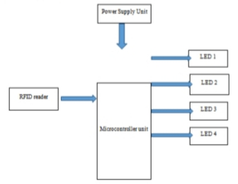
BLOCK
DIAGRAM

Slide 4
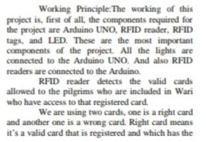
Working Principal
.

Slide 5
